Slide 1

Title Slide
Notes:
[INTRO SLIDE]

Slide 2
1.
Campaign Tag Line
Notes:
[OVERVIEW]

Slide 3
Tag Line
Notes:
[OVERVIEW CONT’D: MESSAGE]

Slide 4
2.
Target Audience
Notes:
[TARGET GROUPS]

Slide 5
Target Groups
Notes:
[TARGET GROUPS]

Slide 6
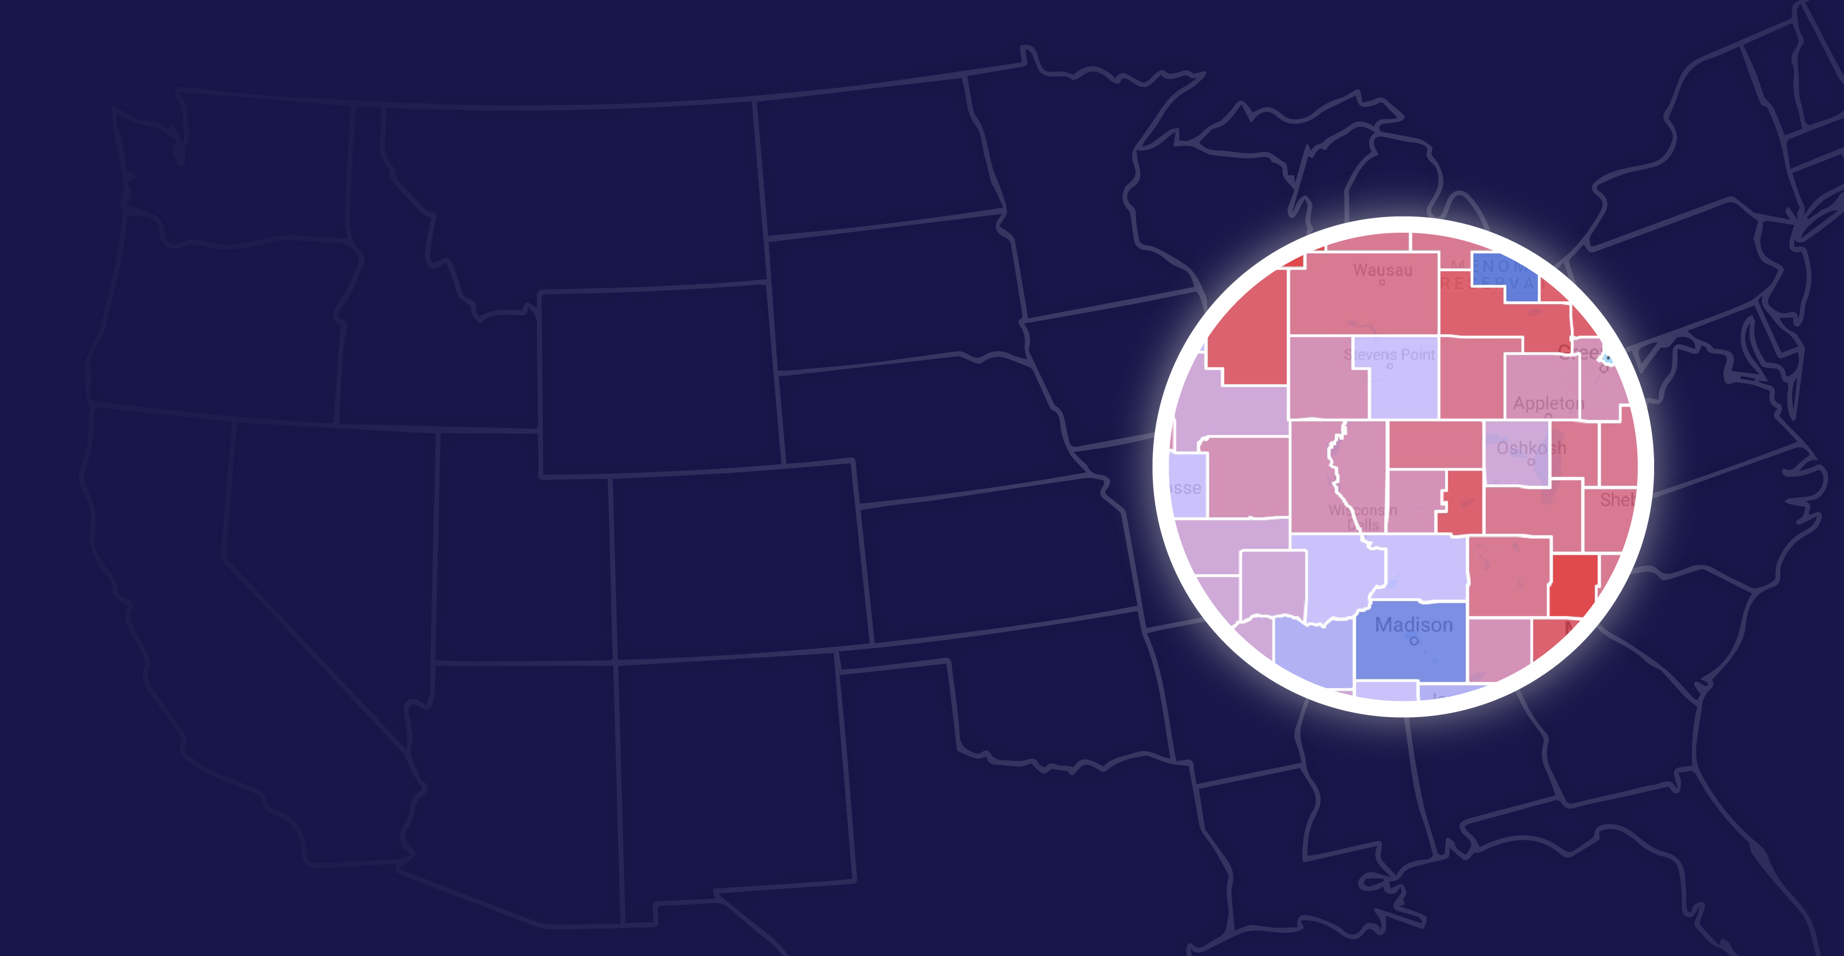
3. Where are our target voters?
Notes:
[TARGET MARKETS]

Slide 7
Media Markets
Notes:
[TARGET MARKETS]

Slide 8

4.Campaign Strategy
-
Notes:
[STRATEGY AND MESSAGING]

Slide 9
Tag Line
Notes:
[MEDIA AUDIT]

Slide 10
5.
Media Buys
Notes:
[MEDIA BUYS]

Slide 11
Notes:
[MEDIA BUYS]

Slide 12
Final Projections
Notes:
[PROJECTIONS]

Slide 13
Our Campaign Will:

Slide 15
Diagrams and infographics

